Slide 1
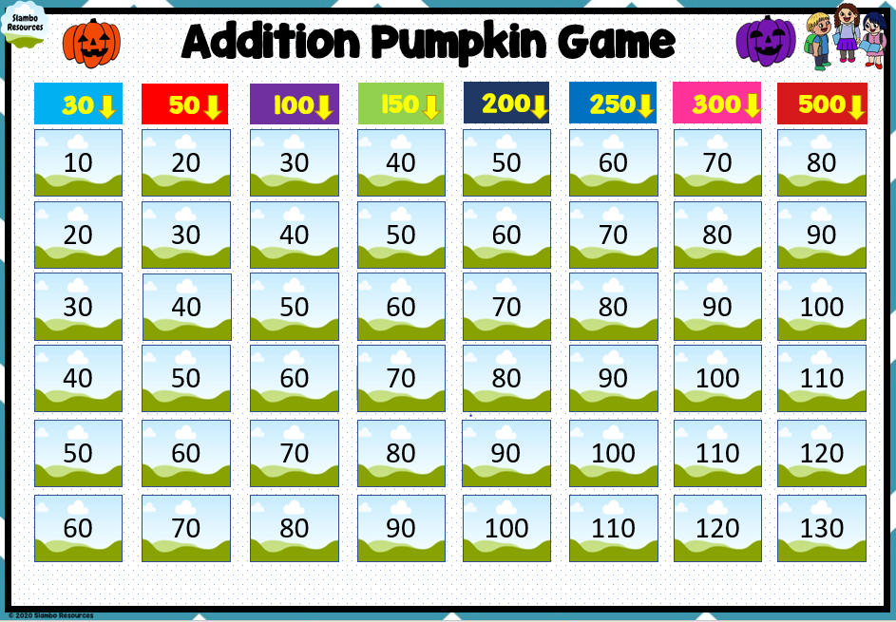
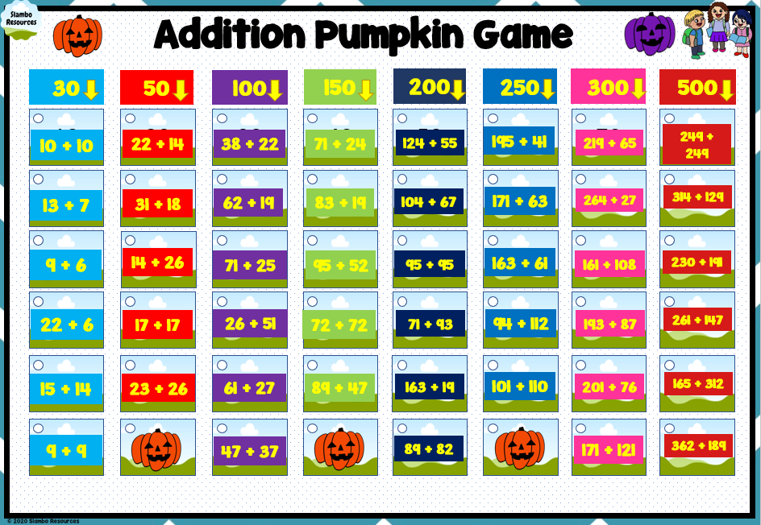
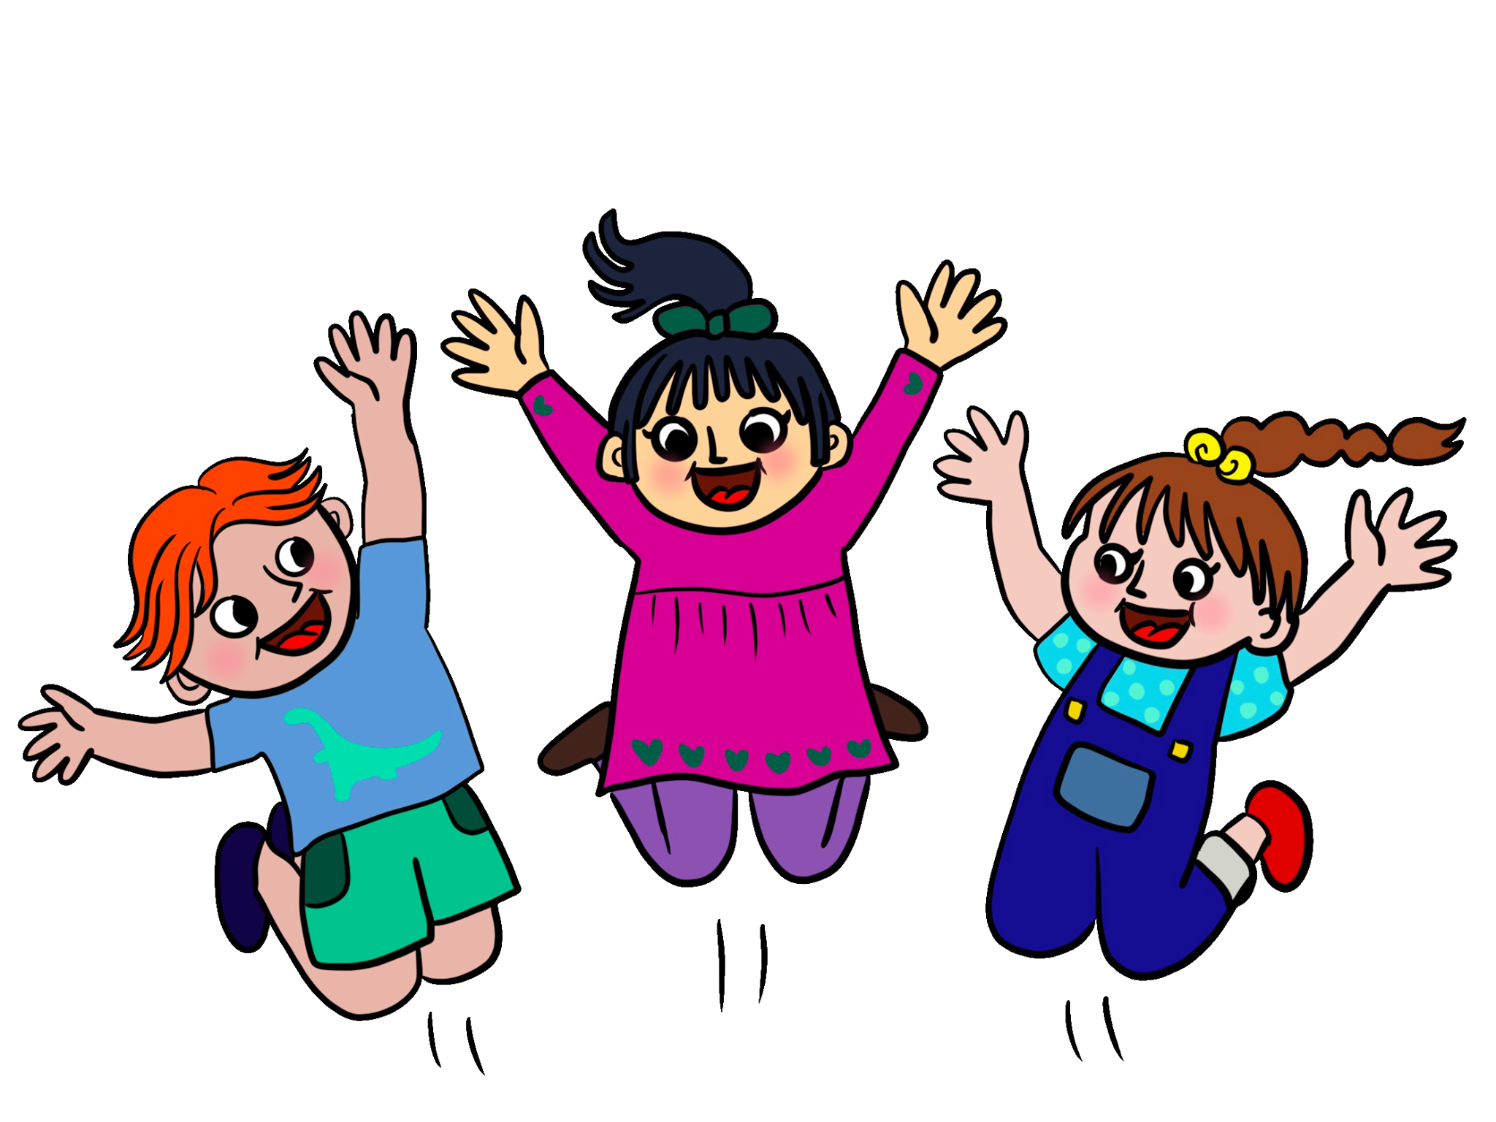
Addition Pumpkin Game

Slide 2
Thank you for using this resource!
Another resource you might like!
Boom Cards!
Some cool fonts with
www.teacherspayteachers.com/Slambo-Resources

Slide 3
Rules – Adapt to your class ☺
1. Divide class into teams of 4
2. Write team names on the board
3. Students pick a topic and points
4. Correct answers = points
5. Incorrect answer = another team can try
6. = lose half your points (there are 3 pumpkins)
7. Game finishes once the 3rd pumpkin is found

Slide 4
Addition Pumpkin Game
30
50
100
150
200
250
300
500
10
20
30
40
50
60
70
80
10 + 10
22 + 14
38 + 22
71 + 24
124 + 55
195 + 41
219 + 65
249 + 249
20
30
40
50
60
70
80
90
13 + 7
31 + 18
62 + 19
83 + 19
104 + 67
171 + 63
264 + 27
314 + 129
30
40
50
60
70
80
90
100
9 + 6
14 + 26
71 + 25
95 + 52
95 + 95
163 + 61
161 + 108
230 + 191
40
50
60
70
80
90
100
110
22 + 6
17 + 17
26 + 51
72 + 72
71 + 93
94 + 112
193 + 87
261 + 147
50
60
70
80
90
100
110
120
15 + 14
23 + 26
61 + 27
89 + 47
163 + 19
101 + 110
201 + 76
165 + 312
60
70
80
90
100
110
120
130
9 + 9
47 + 37
89 + 82
171 + 121
362 + 189

