Slide 1
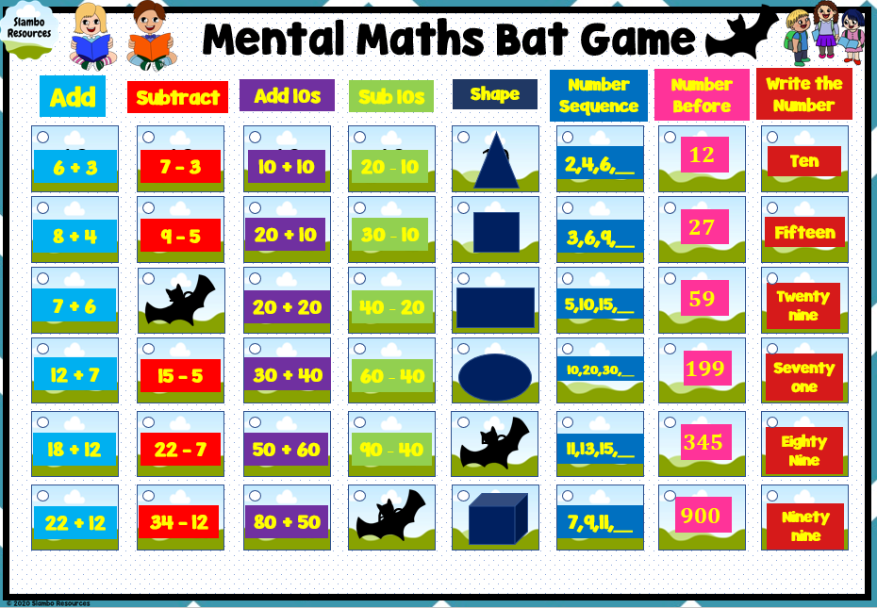
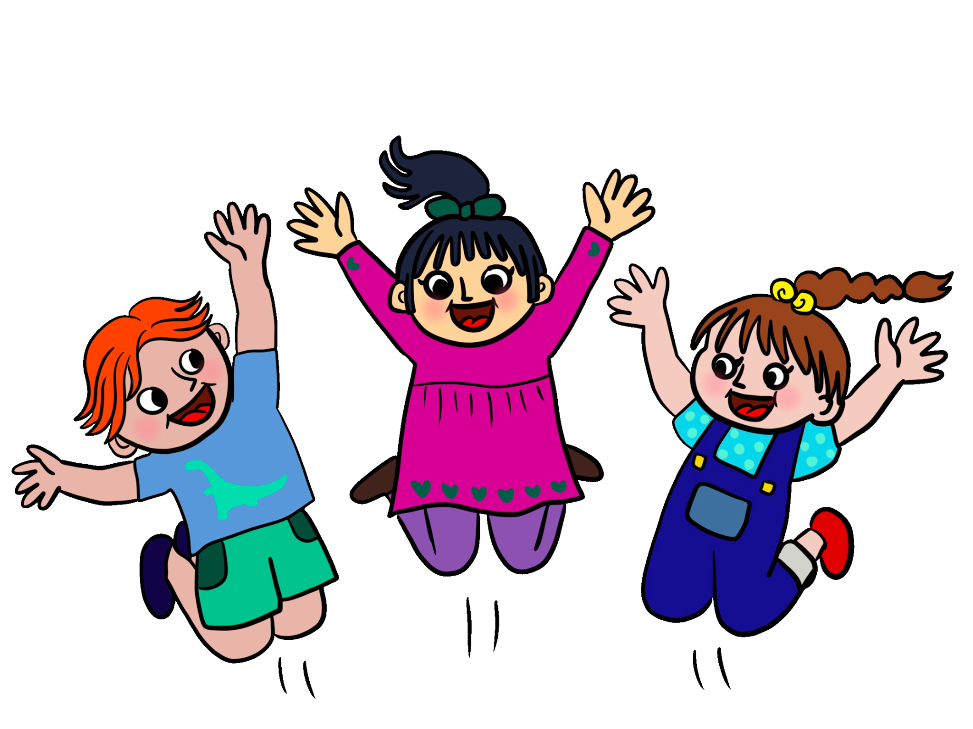
Mental Maths
Bat Game
Grade 1-2
Includes:
45 editable Questions
Addition
Subtraction
Addition by 10s
Subtraction by 10s
Shapes
Number Sequences
Numbers Before
Writing Numbers

Slide 2
Thank you for using this resource!
Another resource you might like!
Boom Cards!
www.teacherspayteachers.com/Slambo-Resources

Slide 3
Rules – Adapt to your class ☺
1. Divide class into teams of 4
2. Write team names on the board
3. Students pick a topic and points
4. Correct answers = points
5. Incorrect answer = another team can try
6. = lose half your points (there are 3 bats)
7. Game finishes once the 3rd bat is found

Slide 4
Mental Maths Bat Game
Add
Add 10s
Sub 10s
Shape
Number Sequence
Number Before
Write the Number
Subtract
10
10
10
10
10
10
10
10
2,4,6,__
$$12$$
Ten
6 + 3
7 - 3
10 + 10
20 - 10
20
20
20
20
20
20
20
20
8 + 4
9 - 5
20 + 10
30 - 10
3,6,9,__
$$27$$
Fifteen
30
30
30
30
30
30
30
30
7 + 6
20 + 20
40 - 20
5,10,15,__
$$59$$
Twenty nine
40
40
40
40
40
40
40
40
12 + 7
15 - 5
30 + 40
60 - 40
10,20,30,__
$$199$$
Seventy one
50
50
50
50
50
50
50
50
18 + 12
22 - 7
50 + 60
90 - 40
11,13,15,__
$$345$$
Eighty Nine
60
60
60
60
60
60
60
60
22 + 12
34 - 12
80 + 50
7,9,11,__
$$900$$
Ninety nine

